Slide 1
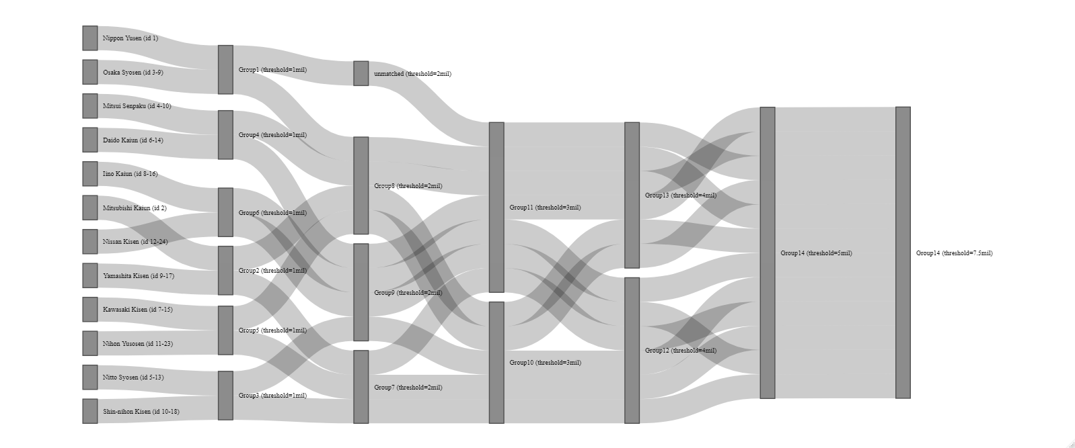
Subsidy threshold
Pre-merger
Data (1mil)
(2mil)
(3mil)
(4mil)
(5mil)
(7.5mil)

Slide 2
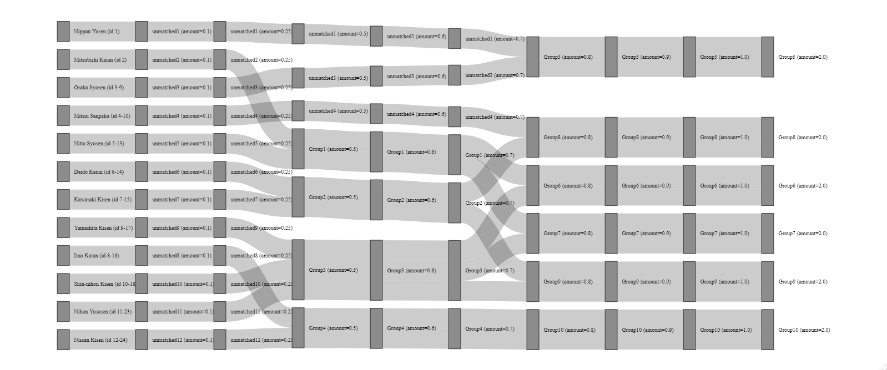
Subsidy amount
Pre-merger (0)
0.1
0.25
0.5
0.6
0.7
0.8
0.9
Data (1: baseline)
2

Slide 3
Bulk Shipping
Homogenous Cargoes
Specialized Shipping
Specialized Cargoes
Liner
Tramper
Tanker
Specialized
(Ore, Timber, etc)

